Slide 1


Analyzing and Predicting Student Academic Performance
DATA 200 Applied Statistical Analysis
Team Members: Kriti Nepal, Aditi Dahal, Samriddhi Sai Khadka
Notes:
1

Slide 2


Problem Statement
"Schools and students lack clear, data-driven insight into how study habits, attendance, and background factors influence academic performance"
Notes:
2

Slide 3
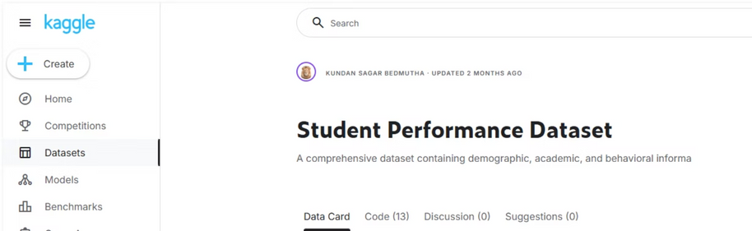
Dataset
Student Performance Dataset from Kaggle
Dataset
Contains information about:
Study hours
Attendance percentage
School type (Public or Private)
Parent education level
Internet access
Travel time to school
The dataset has about 25,000 students, which makes it realistic and reliable for analysis.
Participation in extra activities
Notes:
3

Slide 4
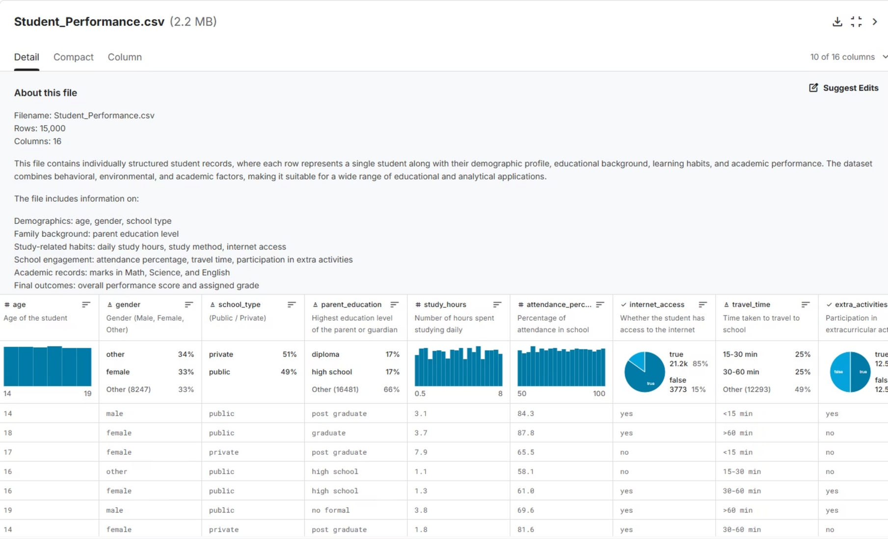
Notes:
4

Slide 5




What We Will Do
Explore Data
Exploratory data analysis (EDA)
Compare Groups
Compare performance of students based on different groups
Analyze Relationships
Use regression and ANOVA to analyze relationships and predict academic performance
Build Application
Build a simple Python application that predicts student performance based on inputs
Notes:
5

Slide 6
Thank you

